Slide 1












A Gentle Introduction to Machine Learning
Dr Eamonn Keogh
University of California - Riverside eamonn@cs.ucr.edu
St. Helena &
Dependencies
South Georgia &
South Sandwich
Islands
Serbia &
Montenegro
(Yugoslavia)
AUSTRALIA
ANGUILLA
U.K.
FRANCE
NIGER
INDIA
IRELAND
BRAZIL

Slide 2
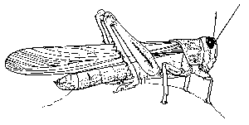
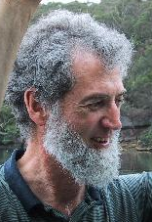
Decision Tree Classifier
10
9
Ross Quinlan
8
7
6
Abdomen Length > 7.1?
Antenna Length
5
no
yes
4
3
Antenna Length > 6.0?
Katydid
2
no
yes
1
Grasshopper
Katydid
1
2
3
4
5
6
7
8
9
10
Abdomen Length

Slide 3
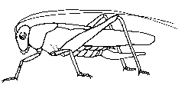
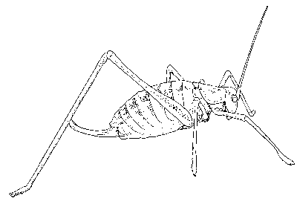




Antennae shorter than body?
Yes
No
3 Tarsi?
Grasshopper
Yes
No
Foretiba has ears?
Yes
No
Cricket
Decision trees predate computers
Katydids
Camel Cricket

Slide 4
Decision Tree Classification
Decision tree
A flow-chart-like tree structure
Internal node denotes a test on an attribute
Branch represents an outcome of the test
Leaf nodes represent class labels or class distribution
Decision tree generation consists of two phases
Tree construction
At start, all the training examples are at the root
Partition examples recursively based on selected attributes
Tree pruning
Identify and remove branches that reflect noise or outliers
Use of decision tree: Classifying an unknown sample
Test the attribute values of the sample against the decision tree

Slide 5
How do we construct the decision tree?
Basic algorithm (a greedy algorithm)
Tree is constructed in a top-down recursive divide-and-conquer manner
At start, all the training examples are at the root
Attributes are categorical (if continuous-valued, they can be discretized in advance)
Examples are partitioned recursively based on selected attributes.
Test attributes are selected on the basis of a heuristic or statistical measure (e.g., information gain)
Conditions for stopping partitioning
All samples for a given node belong to the same class
There are no remaining attributes for further partitioning – majority voting is employed for classifying the leaf
There are no samples left

Slide 6
Information Gain as A Splitting Criteria
Select the attribute with the highest information gain (information gain is the expected reduction in entropy).
Assume there are two classes, P and N
Let the set of examples S contain p elements of class P and n elements of class N
The amount of information, needed to decide if an arbitrary example in S belongs to P or N is defined as
0 log(0) is defined as 0

Slide 7
Information Gain in Decision Tree Induction
Assume that using attribute A, a current set will be partitioned into some number of child sets
The encoding information that would be gained by branching on A
Select that attribute (and that splitting value in that attribute) that maximizes information gain,
i.e. provides the biggest entropy loss.

Slide 8










Person | Hair Length | Weight | Age | Class
Homer | 0” | 250 | 36 | M
Marge | 10” | 150 | 34 | F
Bart | 2” | 90 | 10 | M
Lisa | 6” | 78 | 8 | F
Maggie | 4” | 20 | 1 | F
Abe | 1” | 170 | 70 | M
Selma | 8” | 160 | 41 | F
Otto | 10” | 180 | 38 | M
Krusty | 6” | 200 | 45 | M
Comic | 8” | 290 | 38 | ?

Slide 9
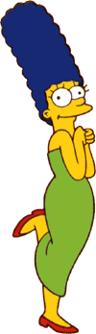


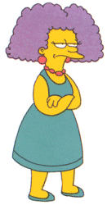
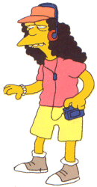
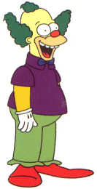


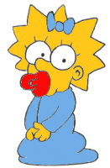
Entropy(4F,5M) = -(4/9)log₂(4/9) - (5/9)log₂(5/9)
= 0.9911
yes
no
Hair Length <= 5?
Let us try splitting on Hair length
Entropy(1F,3M) = -(1/4)log₂(1/4) - (3/4)log₂(3/4)
= 0.8113
Entropy(3F,2M) = -(3/5)log₂(3/5) - (2/5)log₂(2/5)
= 0.9710
Gain(Hair Length <= 5) = 0.9911 – (4/9 * 0.8113 + 5/9 * 0.9710 ) = 0.0911

Slide 10
Entropy(4F,5M) = -(4/9)log₂(4/9) - (5/9)log₂(5/9)
= 0.9911
yes
no
Weight <= 160?
Let us try splitting on Weight
Entropy(4F,1M) = -(4/5)log₂(4/5) - (1/5)log₂(1/5)
= 0.7219
Entropy(0F,4M) = -(0/4)log₂(0/4) - (4/4)log₂(4/4)
= 0
Gain(Weight <= 160) = 0.9911 – (5/9 * 0.7219 + 4/9 * 0 ) = 0.5900

Slide 11
Entropy(4F,5M) = -(4/9)log₂(4/9) - (5/9)log₂(5/9)
= 0.9911
yes
no
age <= 40?
Let us try splitting on Age
Entropy(3F,3M) = -(3/6)log₂(3/6) - (3/6)log₂(3/6)
= 1
Entropy(1F,2M) = -(1/3)log₂(1/3) - (2/3)log₂(2/3)
= 0.9183
Gain(Age <= 40) = 0.9911 – (6/9 * 1 + 3/9 * 0.9183 ) = 0.0183

Slide 12
Of the 3 features we had, Weight was best. But while people who weigh over 160 are perfectly classified (as males), the under 160 people are not perfectly classified… So we simply recurse!
yes
no
Weight <= 160?
This time we find that we can split on Hair length, and we are done!
yes
no
Hair Length <= 2?

Slide 13
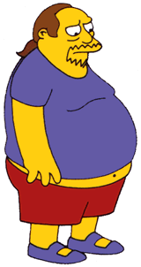
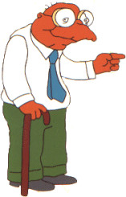

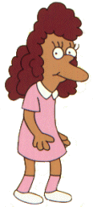
We need don’t need to keep the data around, just the test conditions.
Weight <= 160?
yes
no
How would these people be classified?
Hair Length <= 2?
Male
yes
no
Male
Female

Slide 14
It is trivial to convert Decision Trees to rules…
Weight <= 160?
yes
no
Hair Length <= 2?
Male
yes
no
Male
Female
Rules to Classify Males/Females
If Weight greater than 160, classify as Male
Elseif Hair Length less than or equal to 2, classify as Male
Else classify as Female

Slide 15
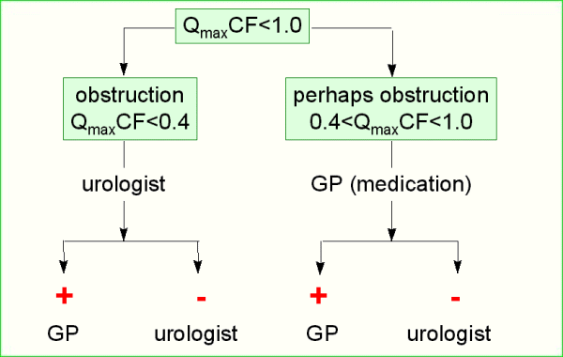
Once we have learned the decision tree, we don’t even need a computer!
This decision tree is attached to a medical machine, and is designed to help nurses make decisions about what type of doctor to call.
Decision tree for a typical shared-care setting applying the system for the diagnosis of prostatic obstructions.

Slide 16
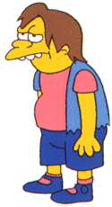
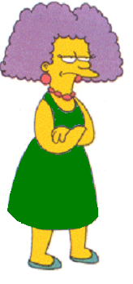
The worked examples we have seen were performed on small datasets. However with small datasets there is a great danger of overfitting the data…
When you have few datapoints, there are many possible splitting rules that perfectly classify the data, but will not generalize to future datasets.
Yes
No
Wears green?
Female
Male
For example, the rule “Wears green?” perfectly classifies the data, so does “Mothers name is Jacqueline?”, so does “Has blue shoes”…

Slide 17
Avoid Overfitting in Classification
The generated tree may overfit the training data
Too many branches, some may reflect anomalies due to noise or outliers
Result is in poor accuracy for unseen samples
Two approaches to avoid overfitting
Prepruning: Halt tree construction early—do not split a node if this would result in the goodness measure falling below a threshold
Difficult to choose an appropriate threshold
Postpruning: Remove branches from a “fully grown” tree—get a sequence of progressively pruned trees
Use a set of data different from the training data to decide which is the “best pruned tree”

Slide 18
Which of the “Pigeon Problems” can be solved by a Decision Tree?
10
9
8
7
6
Deep Bushy Tree
Useless
Deep Bushy Tree
5
4
3
2
1
1
2
3
4
5
6
7
8
9
10
?
100
10
90
9
The Decision Tree has a hard time with correlated attributes
80
8
70
7
60
6
50
5
40
4
30
3
20
2
10
1
10
20
30
40
50
60
70
80
90
100
1
2
3
4
5
6
7
8
9
10

Slide 19
Advantages/Disadvantages of Decision Trees
Advantages:
Easy to understand (Doctors love them!)
Easy to generate rules
Disadvantages:
May suffer from overfitting.
Classifies by rectangular partitioning (so does not handle correlated features very well).
Can be quite large – pruning is necessary.
Does not handle streaming data easily

